Slide 1
37 Billion Mile Challenge: MassVehicleExplorer Submission
By Alexis Chan, Alan Esenther, Kartik Khanna, Allison Patton, Evan Patton
Presented by Alan Esenther
alan.esenther@gmail.com
Notes:
The team members. Team formed at a hackathon.
I worked on and will mostly be talking about the interactive data visualization, but I’ll explain a little about the data, too.

Slide 2
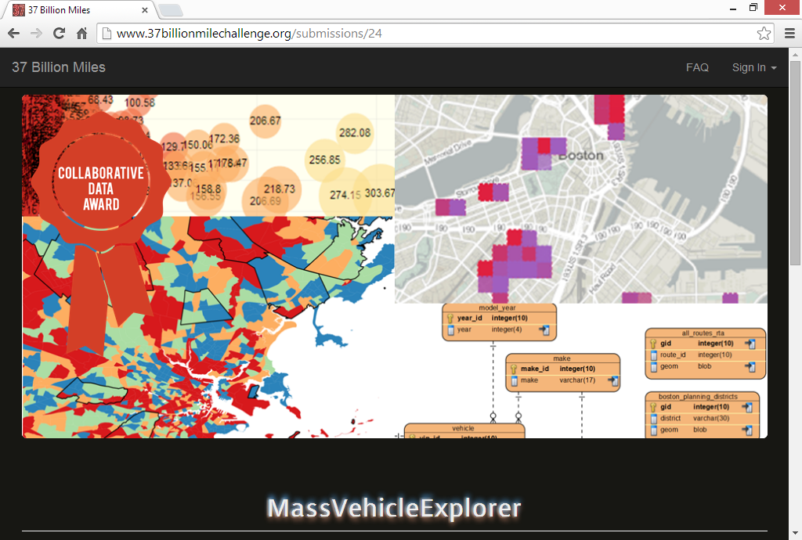
Notes:
Our final entry won the Collaborative Data Award.
One thing they liked is that we didn’t just supply an interactive tool, and data analyses, but:
For creating a full SQL database with lookup tables, spatial data, companion datasets, and information from other sources, and released this via github along with documentation and guidance for setting up a local copy of the database.

Slide 3
https://mass-datathon-cornish-rex.github.io/
Database Requirements
PostgreSQL 9.3
PostGIS 2.1
12 GB disk space
1 GB RAM (possibly less)
Enhanced original data with companion data
Added RTA route geometries
Added Boston planning district geometries
Added counties geometries
Added CTPS Traffic Analysis Zone (TAZ) geometries
Added CTPS TAZ data
Added MA Zip Codes
Added MA Municipality information
Added transit station walkshed geometries
Added Zipcar data
Added mappings from the 250m grid to CTPS TAZ and Zip Codes
Added overlap tables between each 250m grid cell to CTPS TAZ and Zip Codes
Created foreign key relations between existing municipality and Zip columns with new tables
Notes:
This is all in the database provided on github.
Database export that you can import is for Postgres-QL, using the PostGIS extension for spatial data.
RTA -- Regional Transit Authority
CTPS -- Central Transportation Planning Staff
TAZ -- Traffic Analysis Zones
RAE - - Registrations And Estimates

Slide 4
Database Tables
grid_250m_shape
grid_quarters_public
make
model
model_year
municipality
rae_public
spatial_ref_sys
vehicle
Notes:
The challenge provides .csv files.
By using our repository, all of the work of putting it into a relational database has been done for you.
RAE - - Registrations And Estimates

Slide 5
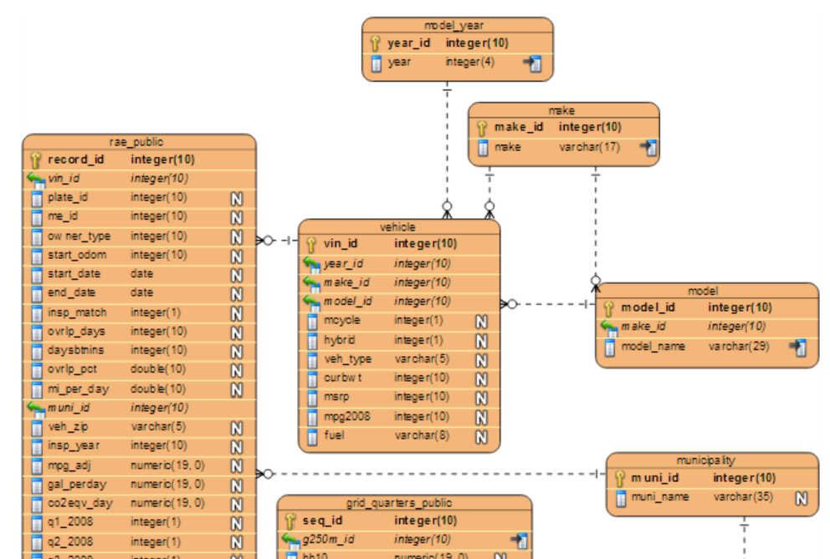
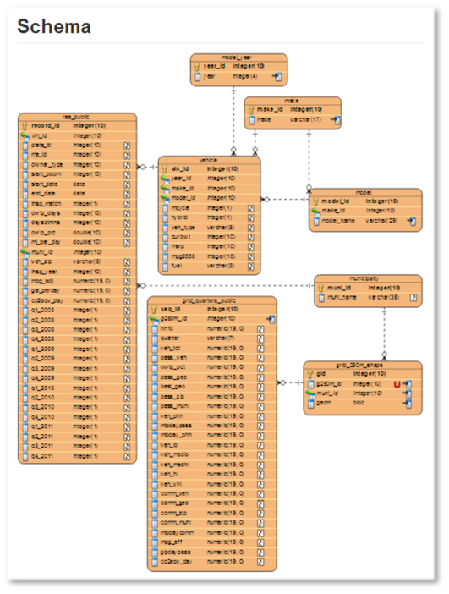
Schema
Notes:
The main registry data table (rae_public = inspection sticker data) points to separate tables containing vehicle data, municipality data, and statistics at 250 meter grid level. Shape information is included for the grids.
A second version of the database, produced after the contest (but also available on the github repository) includes more of the companion data such as zipcar dataset, and shape information for things like planning districts, municipalities, zipcode, and counties.
RAE - - Registrations And Estimates

Slide 6
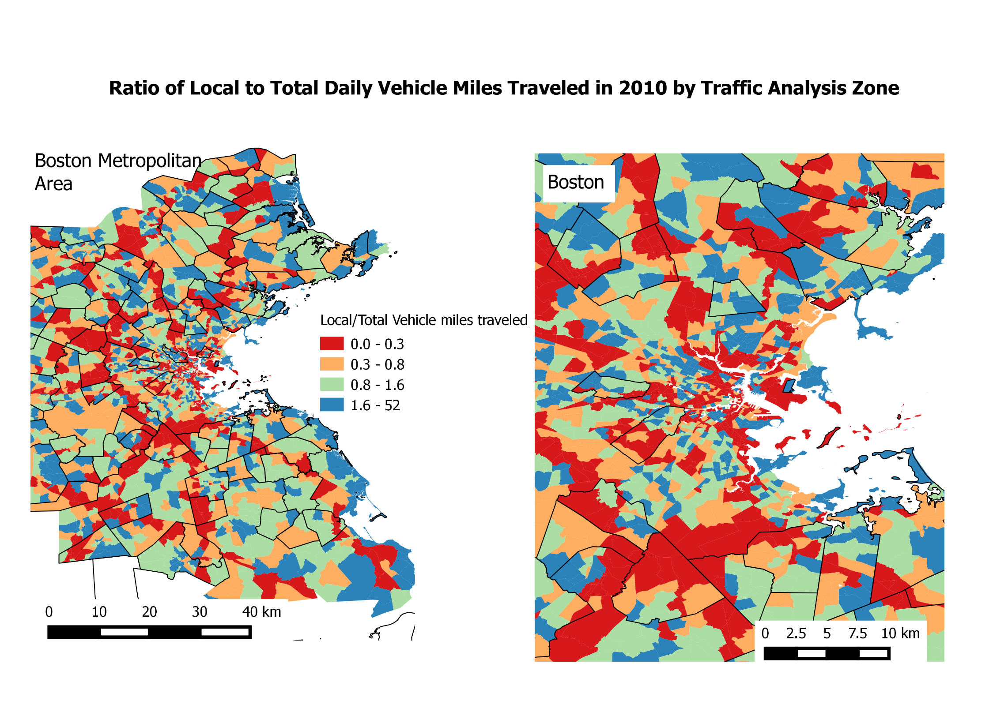
Notes:
Other team members performed some interesting analysis looking at miles travelled and traffic levels.
Refer you to the submission online for details.
Basically looking at miles travelled by each vehicle (based on where it’s garaged) and traffic information. You can see a general trend that cars garaged further from major roads are driven more.
These maps compare the total miles traveled by locally registered vehicles to the total miles traveled. Red areas are highly impacted by region traffic. Not surprisingly, these areas are mainly along the interstate highways. Blue areas have cars with a lot of miles driven, but have relatively little traffic themselves. These areas tend to be outside of Boston and in areas with a lot of commuting.

Slide 7
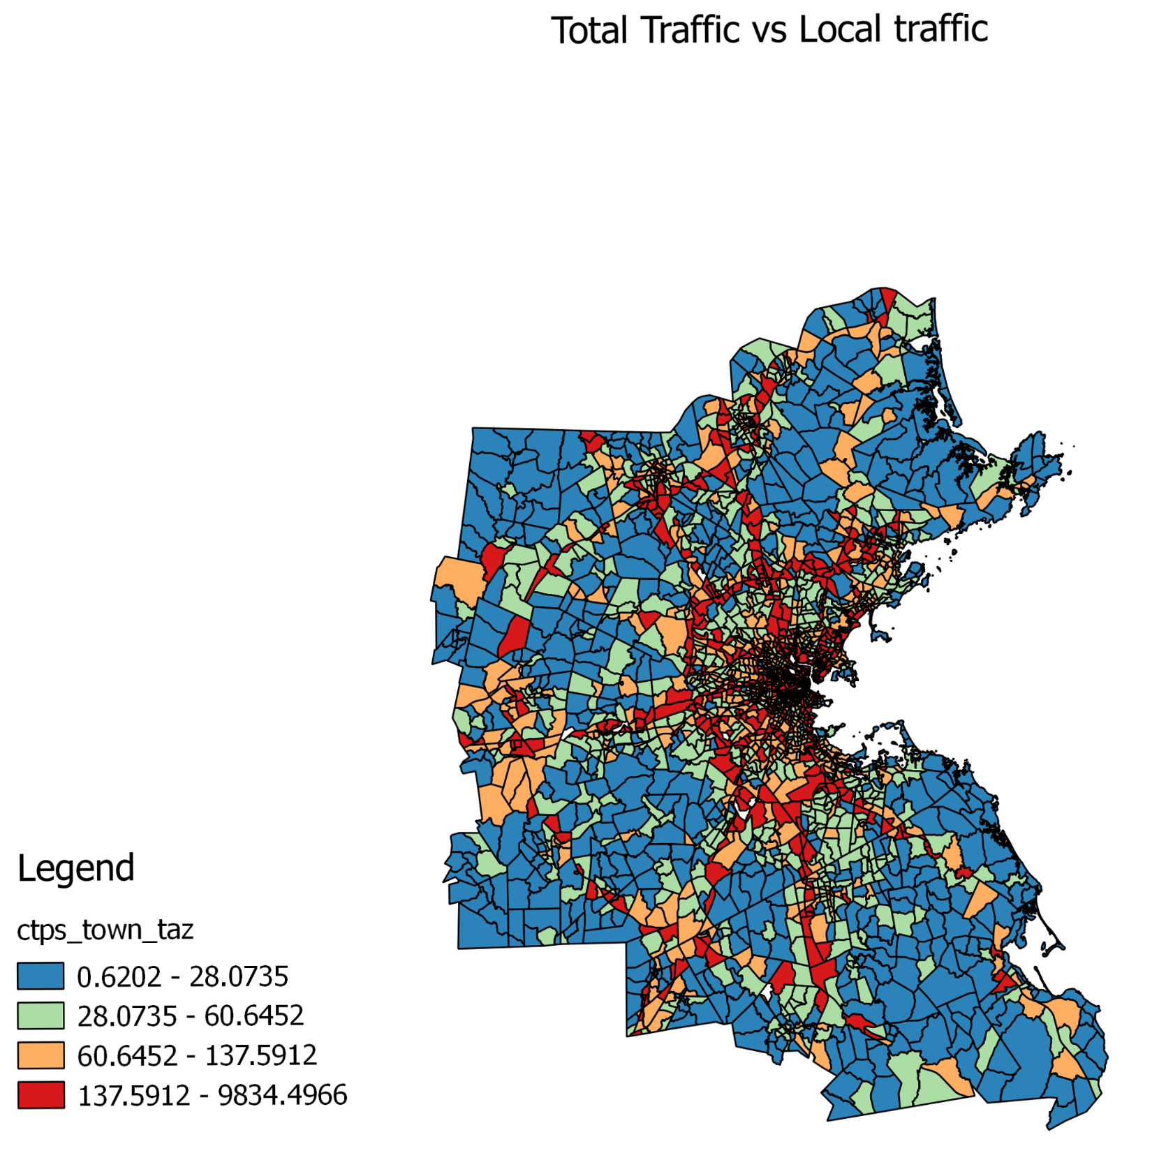
Notes:
Maybe that’s a little easier to see in this image.
This image of the vehicle miles traveled (VMT) divided by total miles per day in each traffic analysis zone (TAZ) highlights the inequality between places with more vehicle traffic and places where the registered cars drive more miles. Near-highway areas and the Boston metropolitan area pop out as places with exceptionally high traffic volumes and low driving.

Slide 8
Data Visualization Software
In-application
Examples: MS Excel, Python, R, STATA
Quick/easy, not generally for interactive visualizations
Business Intelligence Tools
Examples: Tableau, Spotfire and Qlikview
Templates for typical needs, costs money, handles bigger data, more dynamic
Open source libraries
Examples: D3, Processing
Much more flexible, very interactive, allows most creativity, steep learning curve
Notes:
My interest was in creating an interactive data visualization to explore the data.
An exploration tool is different from a data visualization to highlight a particular finding. For one thing, such a visualization to highlight a particular aspect of the data is typically static.

Slide 9
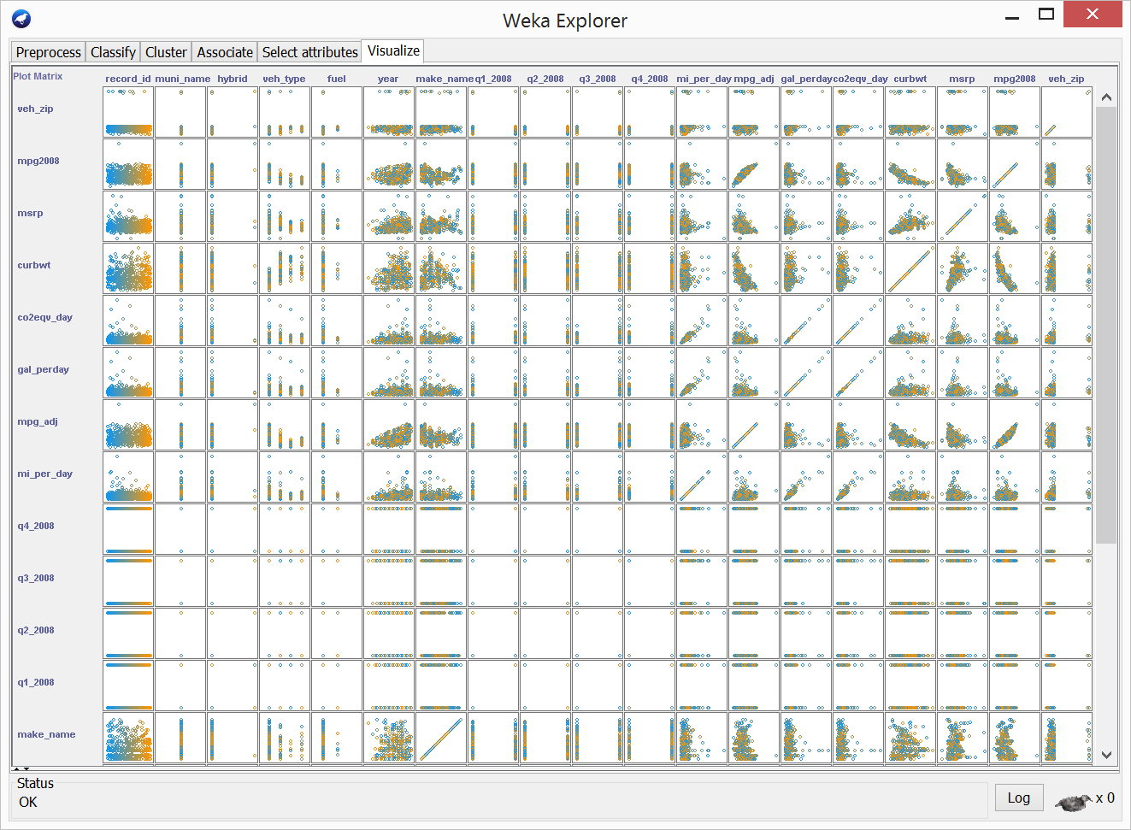
Notes:
I started by loading data into a WEKA and looking at scatterplots.
WEKA (rhymes with Mecca), is open source Java data mining software.
From this I got a sense for what columns might be interesting to extract and use as filters.

Slide 10
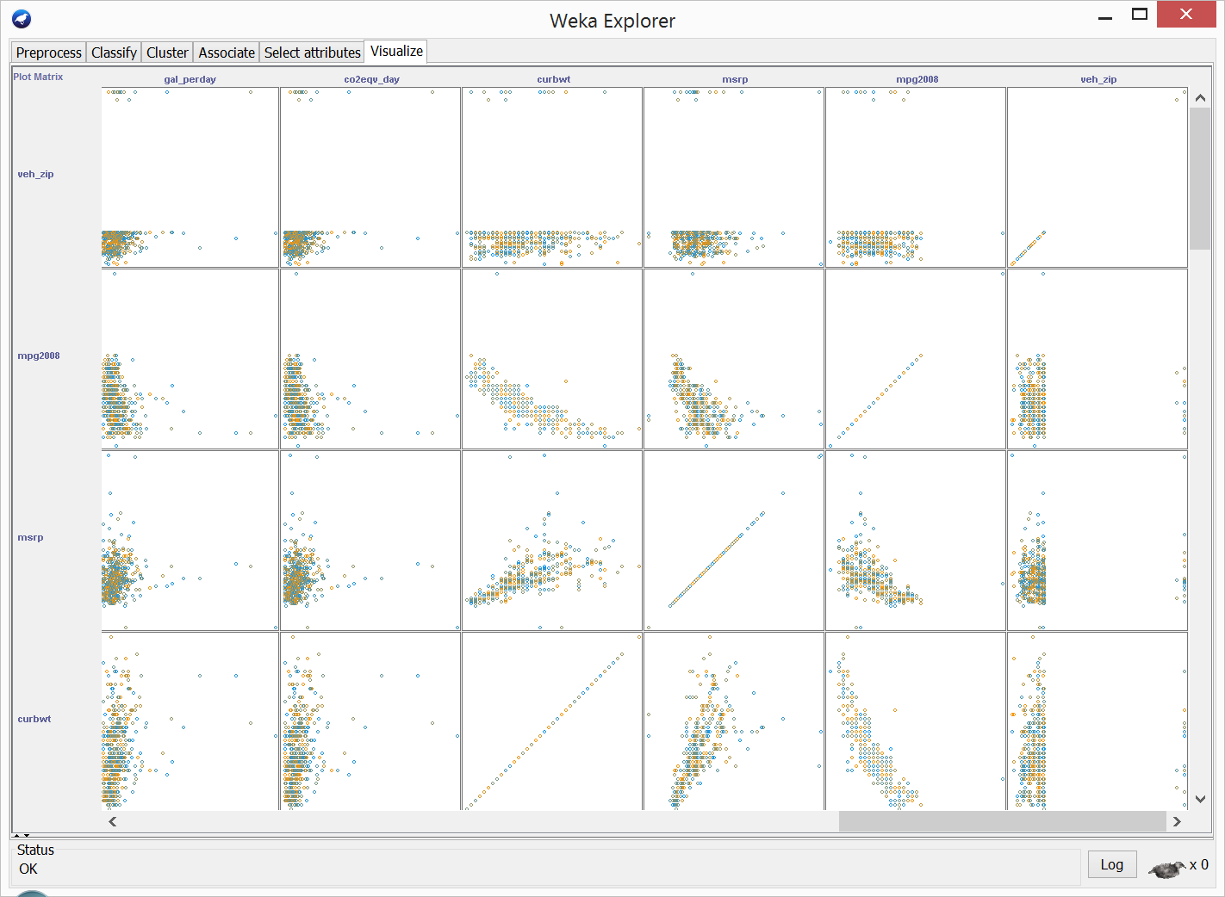
Notes:
Zooming in on some of the scatterplots

Slide 11
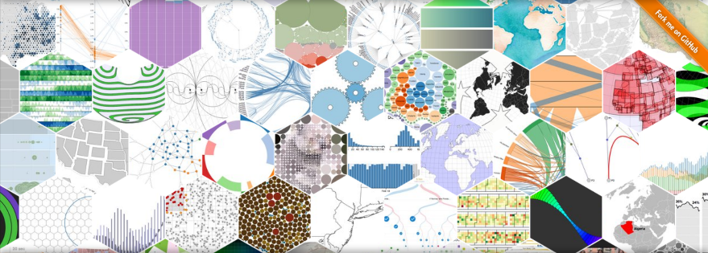
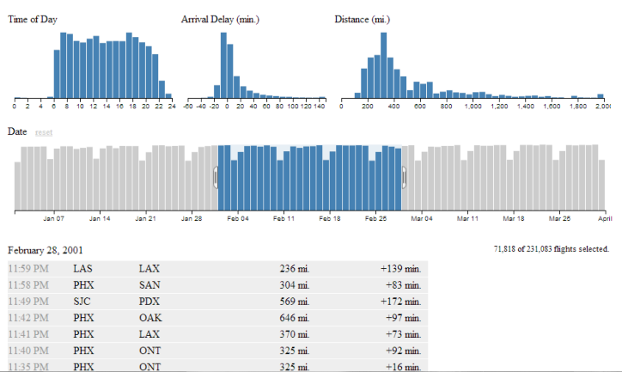
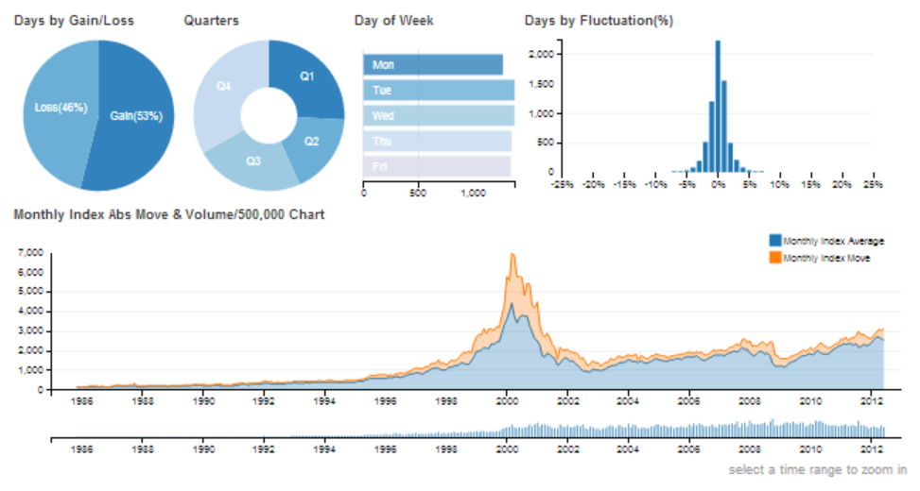
D3.js
Crossfilter.js
dc.js
Notes:
Used this data challenge as an excuse to play with D3.js more
Quickly realized that linked charts would be needed for the exploration tool I had in mind.
Came across Crossfilter library (based on D3.js, and by the same author) which excels at fast multi-dimensional filtering for coordinated views.
Used dc.js (Dimensional Charting) library, built on top of Crossfilter, to add some enhancements (e.g. list or reset currently applied filters for each chart)

Slide 12
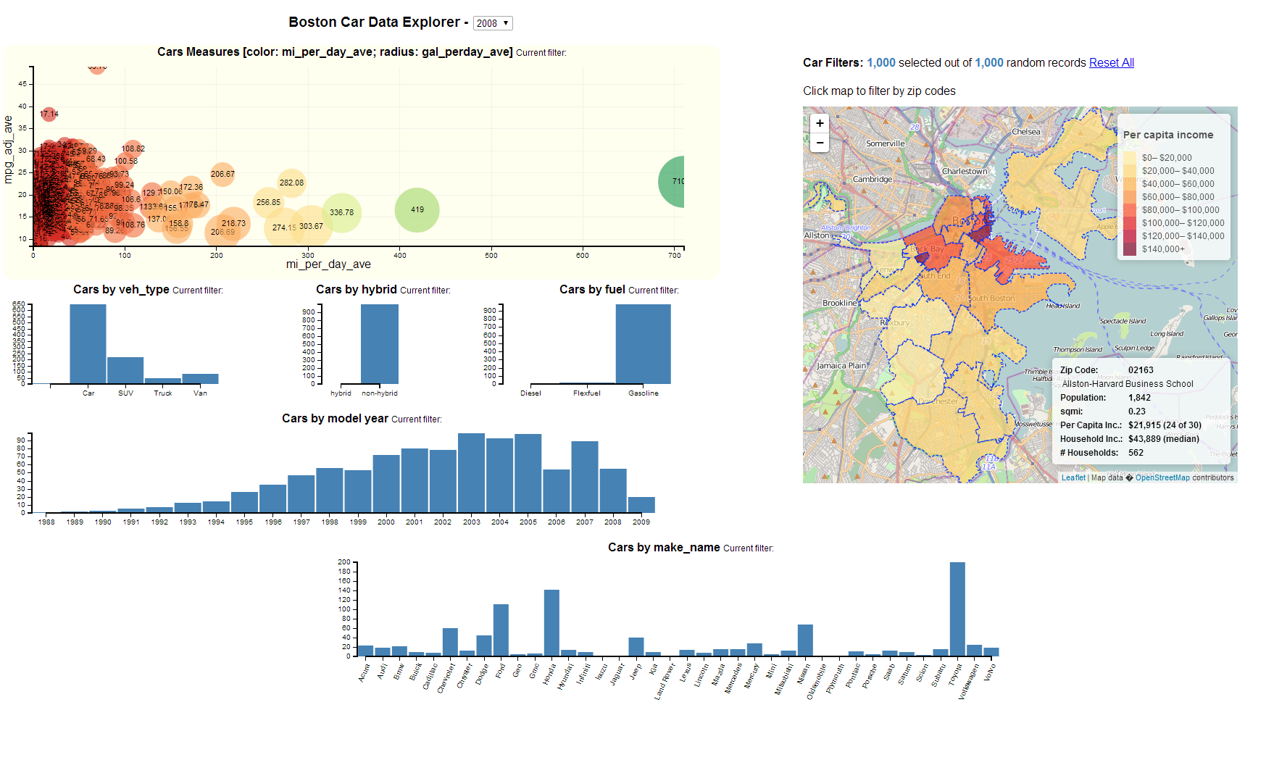
Notes:
Jumping ahead, this is the final Boston Car Data Explorer, laid out as an interactive dashboard (requires a high resolution display).
The idea is to apply a series of simultaneous filters by selecting bars in bar charts, and zipcodes on a map. The filtered data updates a bubble chart showing the selected vehicles.

Slide 13
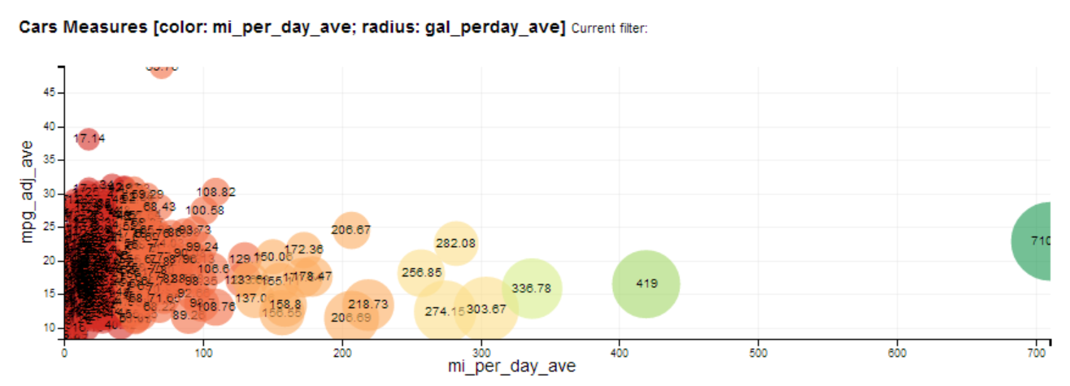
Notes:
Here’s the main bubble chart. Each bubble is a particular car. It plots mile-per-gallon vs miles-driven-per-day, where the bubble size is gallons-per-day. But these measures were chosen not because the resulting plot is particularly insightful so much as that it spreads out the data somewhat. As you apply filters, you can mouse-over a particular car to get the full set of details about it.

Slide 14
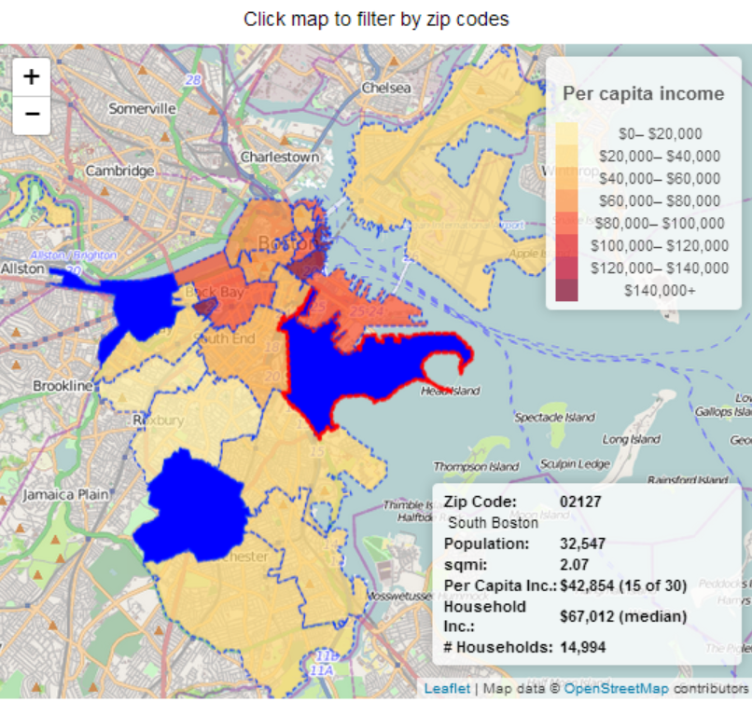
Notes:
Here’s the zipcode map. You can select multiple zipcodes. I scraped income data for each zipcode from Wikipedia to make the color-coding more interesting. Mouseovers provide all details about a given zipcode (e.g. population, # of households, per capita income and ranking).
Problem here was that the Javascript libraries had built-in support to show maps, and even use them as filters, but the maps were static. I wanted to be able to zoom in on them. Eventually went with Leaflet JavaScript libraries. There are known problems getting Leaflet to work with D3 (2 solutions are discussed in the forums), I mostly got it to do what I wanted.

Slide 15
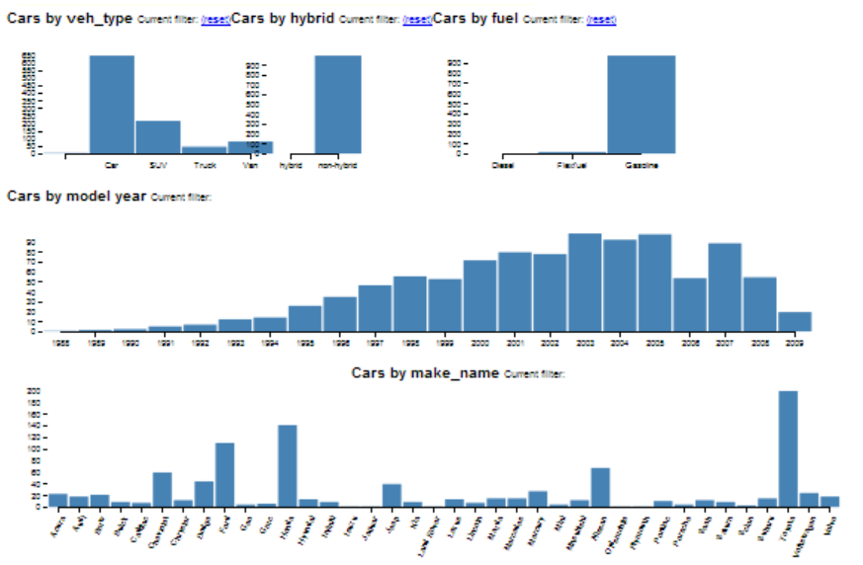
Notes:
These are the bar charts that you can use to filter data. You can select multiple bars in each chart and it’s all linked. So if you select the SUV bar in the vehicle_type bar chart, then the Year and Car_Make bar charts will be updated to only reflect vehicles that are SUVs.
Charts include:
+Vehicle_type: Car, SUV, Truck, Van
+Whether it’s a Hybrid vehicle or not
+Fuel_type: Diesel, Flexfuel, Gasoline [Flex-fuel: usually gasoline in same tank w/either ethanol or methanol]
+Model_Year: 1998 to 2009
+Car_Make: Acura thru Volvo

Slide 16
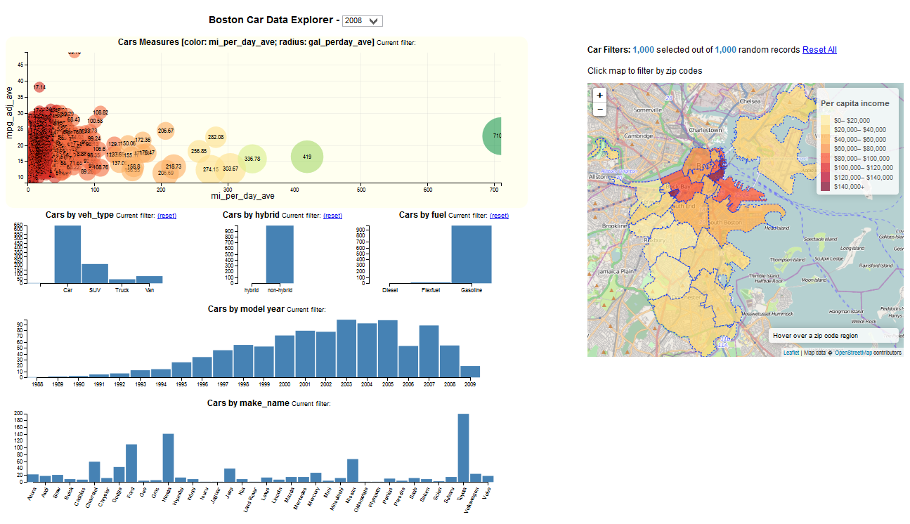
Notes:
Boston Car Data Explorer with no filters applied

Slide 17
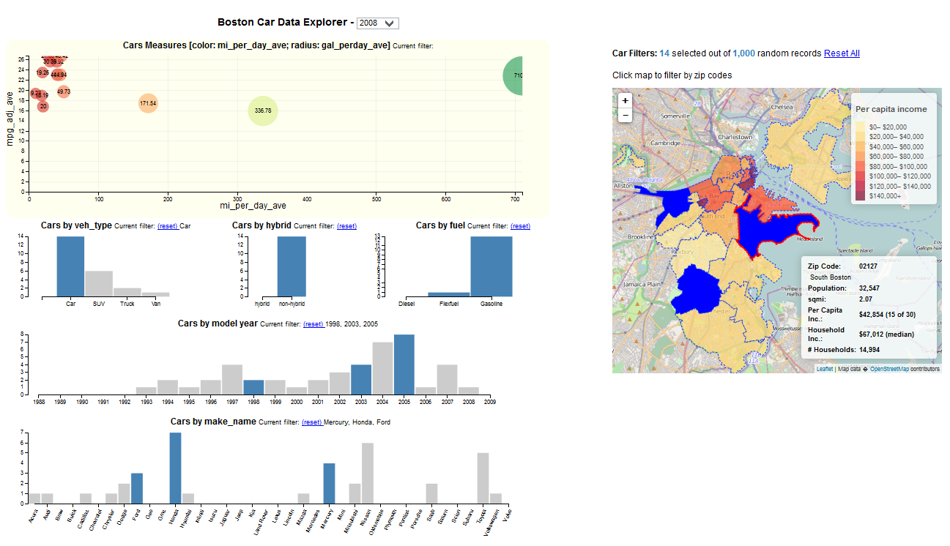
Notes:
Filtered by 3 zipcodes, cars (vs truck or SUV), 3 particular model years, and 3 particular car makes)
More exciting to view on line, since it’s based on D3.js which has animations built-in.
[Flip back and forth with previous slide]

Slide 18
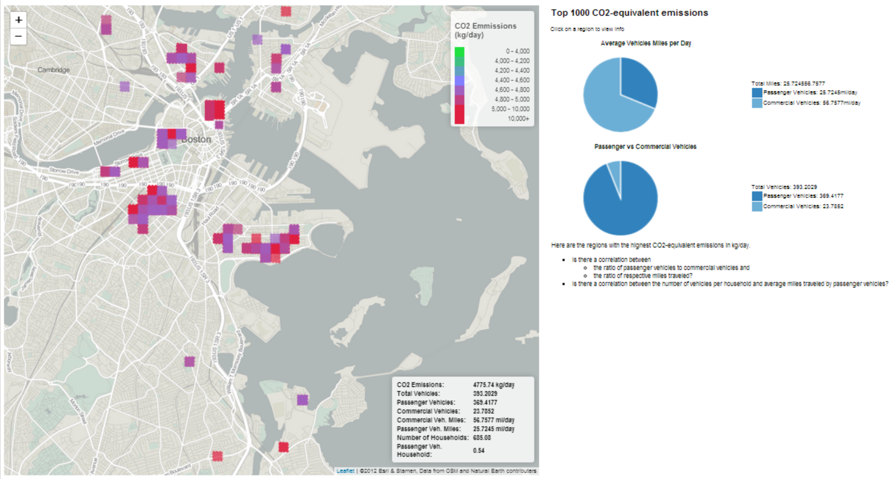
Notes:
Another member of the team took the Car Data Explorer code and hacked it to quickly create this interactive map of carbon dioxide emissions.

Slide 19

Collaborative Data Award
“The Mass Vehicle Explorer covered many of the angles we hoped for with the data challenge. The team built an interactive tool that allowed for exploration of vehicle level data (the Boston Car Data Explorer) and they combined the dataset with information from other sources to yield a novel analysis about disproportionate neighborhood impacts ("Who impacts Whom?"). Most remarkable was their commitment to open data and their willingness to share their insights and data infrastructure so that other contestants and data users could leverage their work.”
“The willingness of the team to openly share their work exemplifies the spirit of this initiative and earned them the Collaborative Data Award.”
http://www.37billionmilechallenge.org/submissions/24

Slide 20
37 Billion Mile Challenge: MassVehicleExplorer Submission
By Alexis Chan, Alan Esenther, Kartik Khanna, Allison Patton, Evan Patton
Presented by Alan Esenther
(Email for slides)
alan.esenther@gmail.com

Slide 21
Extra slides

Slide 22
37 Billion Mile Data Challenge
The Massachusetts Vehicle Census Data
Anonymized information about the age, model, estimated mileage, fuel efficiency, and zip code of passenger and commercial vehicles registered in the state from 2008 to 2011
A spatial dataset of 250 meter grid cells with statistics on vehicles per household, mileage per vehicle, and greenhouse gas emissions
A companion package including a wide range of spatial data, including population, businesses, property statistics, and the built environment, for each grid cell (available in the Datathon Treat)
Notes:
500GB dataset provided in the challenge was largely based on data collected when drivers get their annual Massachusetts inspection stickers
They also broke down the statistics to 250meter grids of all of Massachusetts.

Slide 23
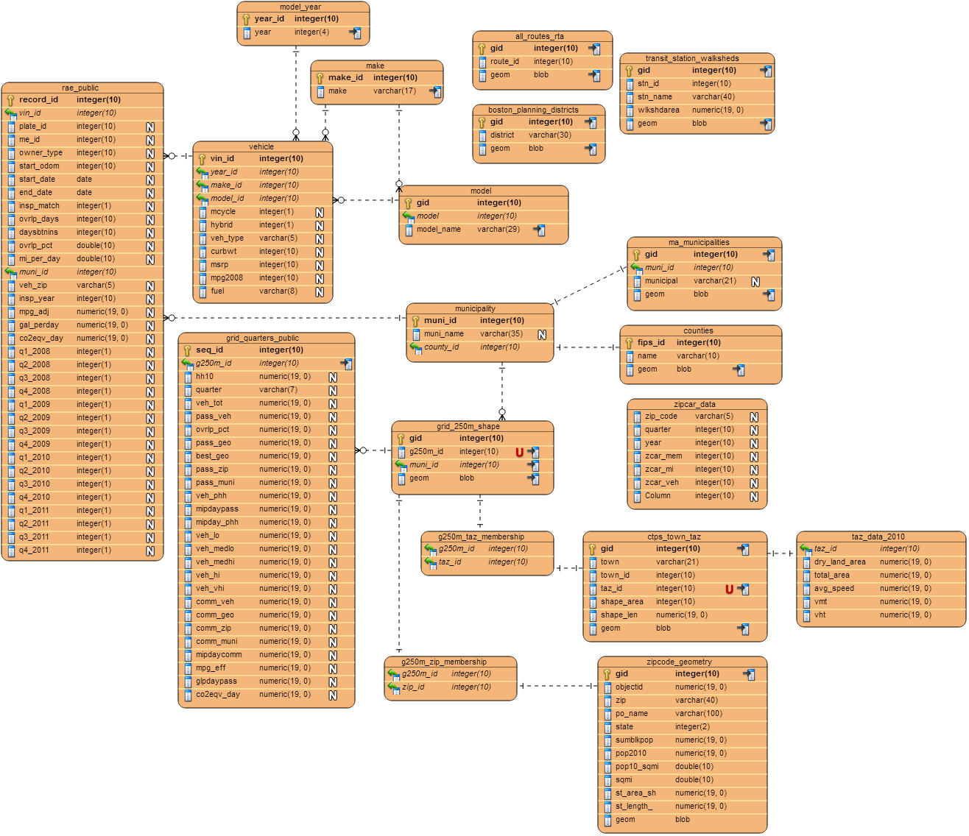
Schema v2

Slide 24
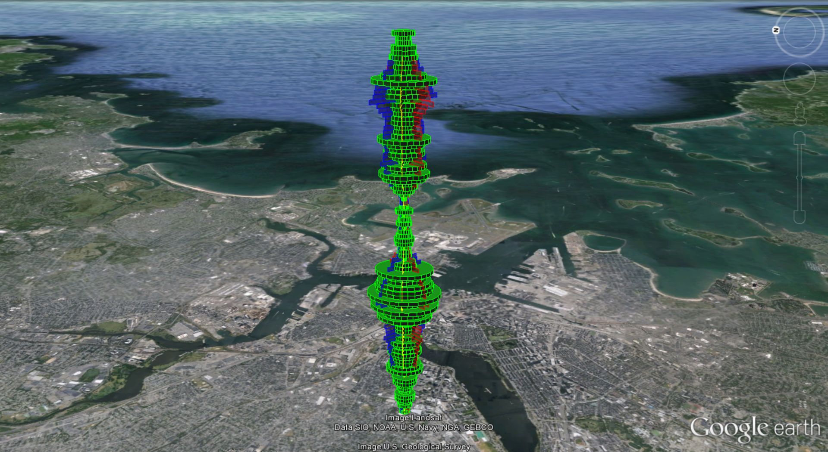
Notes:
Finally, this is some fanciful 3D work using Google Earth that I started working on. The idea here was to put one of these structures at each zip code. Height represents time slices. Colorful bump-outs were to represent different measures such as miles-per-gallon or CO2 emissions.
Amusing, but ran out of time.

